Slide 1


TOPIC : PATIENT MALADY DETECTION USING MACHINE LEARNING AND
DEEP LEARNING APPROACHES
( Focus : Intelligent Healthcare System for Heart Disease Detection using Machine Learning and Deep Learning) -- PROJ3
RCC INSTITUTE OF INFORMATION TECHNOLOGY
Course Name : Project-II
Course Code : PROJ-IT781
Team Member :
Pradipta Kumar Talukdar ( 11700222071 )
Swapnadeep Podder ( 11700222009 )
Sarmistha Moharer ( 11700222124 )
Nandita Paul ( 11700222101 )
Under Supervision of Mr. Monojit Manna

Slide 2
Problem Description : Patient Malady Detection using Machine Learning & Deep Learning
(Focus: Cardiovascular Disease)
ML/DL-based disease detection has grown with the expansion of healthcare data
Most AI models are not yet production-ready for real clinical deployment
Existing approaches rely on isolated clinical parameters, limiting reliability
Cardiovascular assessment requires integrated cardiac and non-cardiac evidence
Lack of rule-based decision logic reduces clinical trust and consistency
These limitations hinder accurate, reliable, and practical clinical decisions

Slide 3
Related work
Author Name | Paper Name | Challenges | Research Gap | Contribution
Smith et al. | Explainable Machine Learning Models for Clinical Decision Support: Challenges and Future Directions | Lack of model explainability, clinician trust issues, and data bias | Need for explainable and transparent AI models suitable for real-time clinical use | Machine learning models improved accuracy in laboratory result interpretation and assisted clinicians in diagnosis
Lee et al. | A Hybrid Rule-Based and Machine Learning Framework for Medical Decision Support Systems | Limited scalability, rigid rule structures, and difficulty handling complex cases | Hybrid systems combining rule-based logic with machine learning for better adaptability | Rule-based systems provided clear and interpretable medical decision support
Johnson et al. | C-Reactive Protein Combined with Clinical Indicators for Predicting Cardiovascular Events | Focused on a single biomarker, limited predictive capability | Multi-parameter models integrating CRP with other clinical indicators | Identified a strong correlation between C-reactive protein levels and cardiovascular disease risk
Kumar et al. | Evaluating AI-Enabled Healthcare Chatbots: Accuracy, Privacy, and Clinical Validation | Inaccurate responses, privacy concerns, and lack of medical validation | Clinically validated chatbot systems integrated with healthcare databases | AI chatbots enhanced early symptom collection and improved patient engagement

Slide 4
Proposed Solution
Multifactorial Clinical Analysis Framework
Stepwise, Clinically Approved Diagnostic Workflow
Hybrid Machine Learning and Deep Learning Architecture
Correlation of Cross-Modal Medical Findings
Custom-Trained Medical LLM for Clinical Reporting and Decision Support

Slide 5
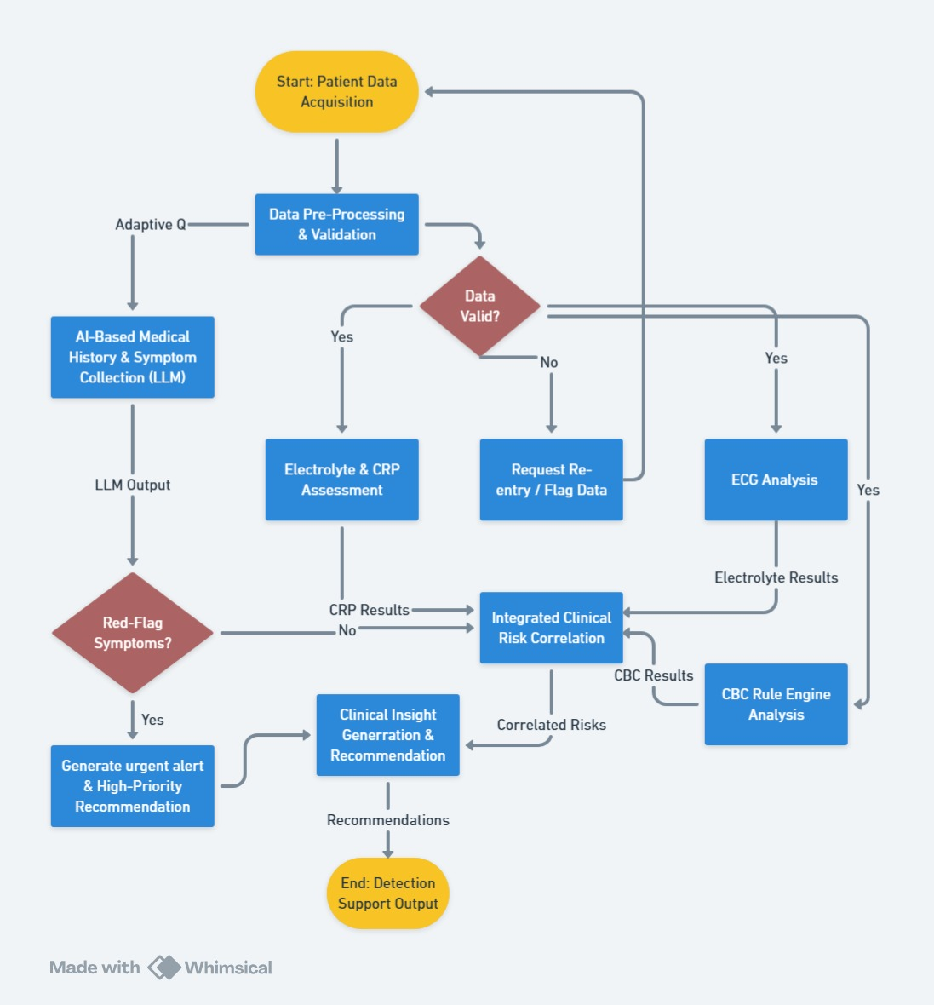
Project Workflow

Slide 6
Results :
Rule-based interpretation was implemented for CBC, CRP,and electrolyte parameters relevant to cardiac pathology.
Using 13 standard clinical parameters, an SVM-basedmodel achieved 91% accuracy in heart disease detection.
A 12-lead ECG analysis system was developed with 72clinically defined classes and subclasses.
R-peak detection and beat segmentation enabled detailedelectrical activity analysis.
Echocardiography processing extracted left ventriculararea, shape, axis, eccentricity, and wall thicknessparameters.
Disease possibility was inferred by correlating laboratory,ECG, and imaging findings through rule-guided logic.

Slide 7
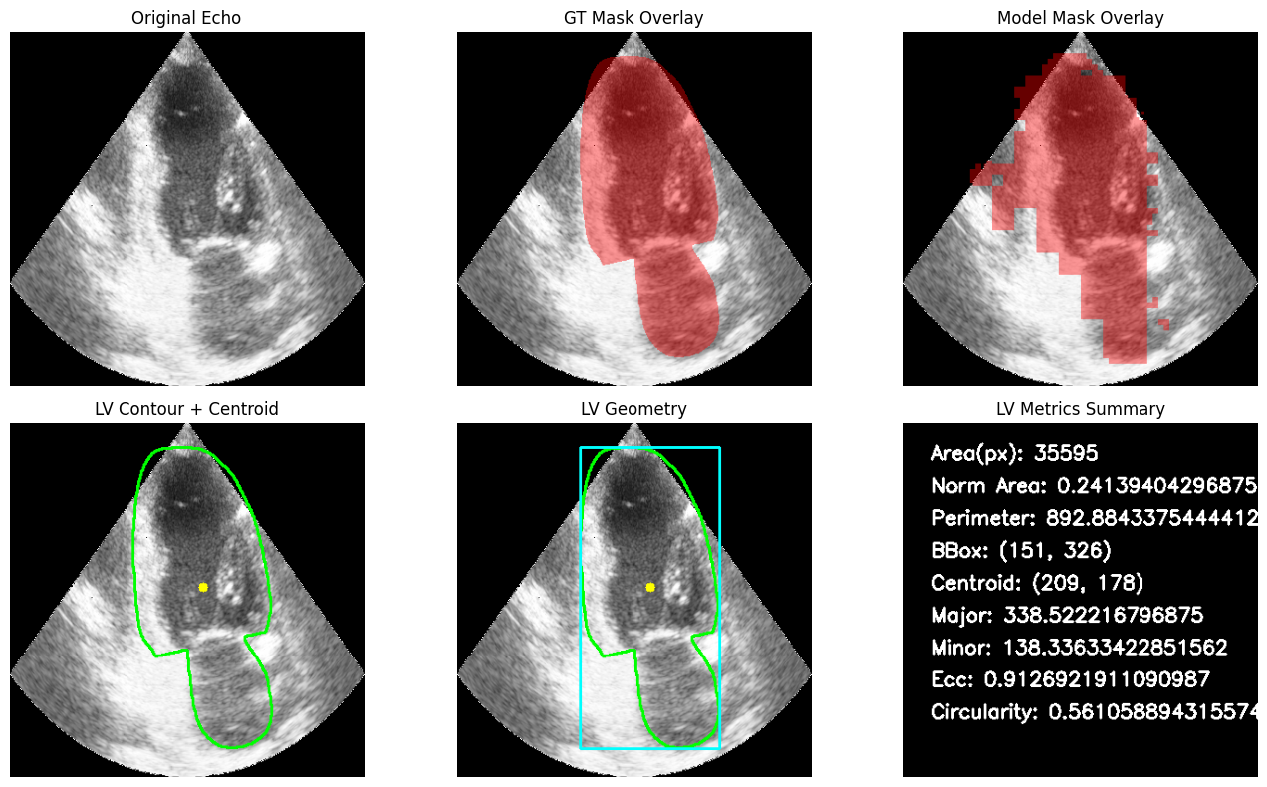
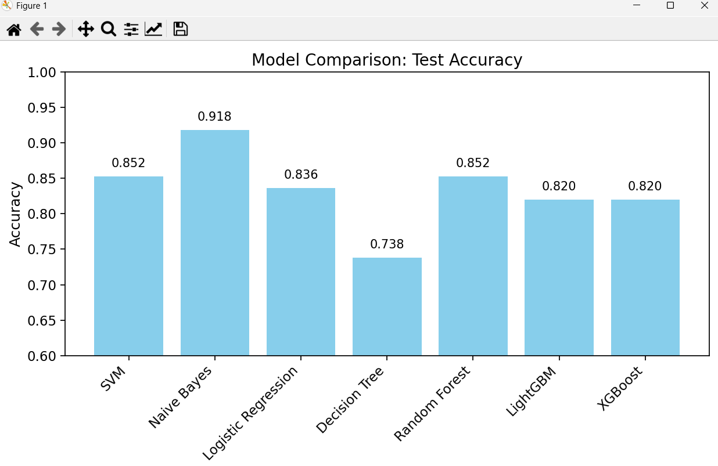
Results – II

Slide 8
References
J. Smith and R. Allen, “Clinical decision support systems in healthcare,” Proc. IEEE Int. Conf. Healthcare Informatics (ICHI), Xi’an, China, pp. 1–6, 2019.
A. E. W. Johnson et al., “MIMIC-III: A freely accessible critical care database,” Scientific Data, vol. 3, no. 1, Art. no. 160035, 2016.
(Widely used for cardiovascular and ICU research).
E. J. Topol, “High-performance medicine: The convergence of human and artificial intelligence,” Nature Medicine, vol. 25, pp. 44–56, 2019.
A. Rajkomar, J. Dean, and I. Kohane, “Machine learning in medicine,” New England Journal of Medicine, vol. 380, no. 14, pp. 1347–1358, 2019.
B. A. Goldstein, A. M. Navar, and M. J. Pencina, “Opportunities and challenges in developing risk prediction models with machine learning,” Journal of the American College of Cardiology, vol. 69, no. 7, pp. 845–847, 2017.
(Cardiology-specific ML paper).
World Health Organization, Ethics and Governance of Artificial Intelligence for Health. Geneva, Switzerland: WHO, 2021.
M. M. Ahsan et al., “Machine-learning-based disease diagnosis: A comprehensive review,” Healthcare, vol. 10, no. 3, Art. no. 541, 2022.
C. Szegedy et al., “Going deeper with convolutions,” Proc. IEEE Conf. Computer Vision and Pattern Recognition (CVPR), Boston, MA, USA, pp. 1–9, 2015.
(Core CNN architecture used in cardiac imaging).

Slide 9
